Slide 1
Cognitive Music
Activity-Sensitive Audio for Stimulatory Cognitive Control

Slide 2
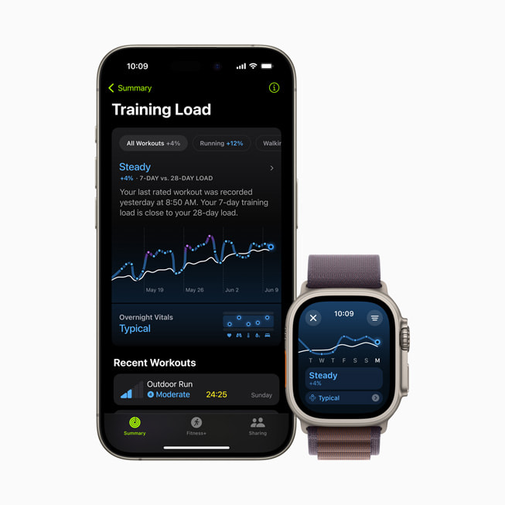
Activity Data Encoder
Wearable Sensor Data (Apple Watch
heartrate, gyro, accel. (also magnet., altim.)
Audio Data
See Meta MusicGen Encoder; consider pretraining cost savings, finetuning & cross-attentive / TFT style multimodal
Compare with brain Digital Twin inverse-path modeling, esp. research needs, academic grounding
Compute intensity? Latency effects?
Train Classifier(ex) or import preexisting classifier.
Longterm; RLHF policy improvements and UI semantic prompt eng.
Gemma-type LLM to generate train-of-thought type semantics, or simply list-of-words input

Slide 3
“Latent Space” – Audio Model Input
Run activity info + existing prompt into audio input..
User interface controls:
Dials changing input prompt, latent output temperature for customization

Slide 4
Audio Decoder
Audio model with latent / semantic context input
Context shifting, realtime indicators for latency management
Synthesizer-type audio control (see MIT lab)
Pretraining/RL with larger multimodal model for labelling & task convergence
Cross-attentive / TFT-type architecture for multiple context sources
Finetuned/pretrained generative music model – investigate input, latency

